Slide 1

Extract Trends from social media data
Team Name: Coder123
Institute Name: Chandigarh University

Slide 2
Team Members:
Team Name: | Coder123
Institute Name: | Chandigarh University
Team Members | Leader | 2nd Member | 3rd Member
Name | Puru | Shikhar Gupta | Shivkesh Pandey
Batch | 2024 | 2024 | 2024

Slide 3
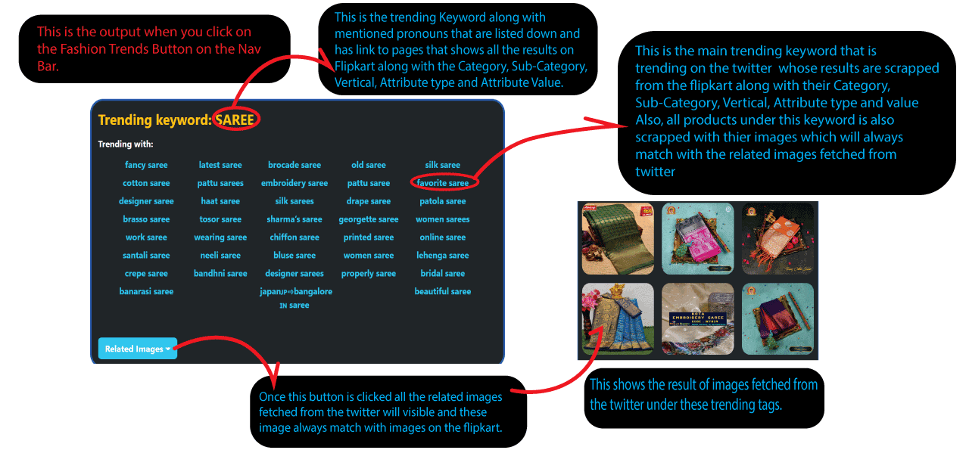
P0: Finding the Trending Keywords

Slide 4
P1: Ranking/scoring logic for trends extracted
All these trending keywords are sorted on the Bases of a algorithm designed by our team which is as fallows:
Retweets are given highest Star-Point which is 10 per Retweet.
Likes are given Second Highest Star-Point which is 9 per Like.
3. Now total Star-Point is reduced on the basis of how old a particular tweet is. 0.1% decrease for 1 day old Tweet.
Also if the tweet contains a media then there is rise in Star-Point of 10000.
Moreover, if the tweet is explicit then there is decrease in the Star-Point of 10000.

Slide 5
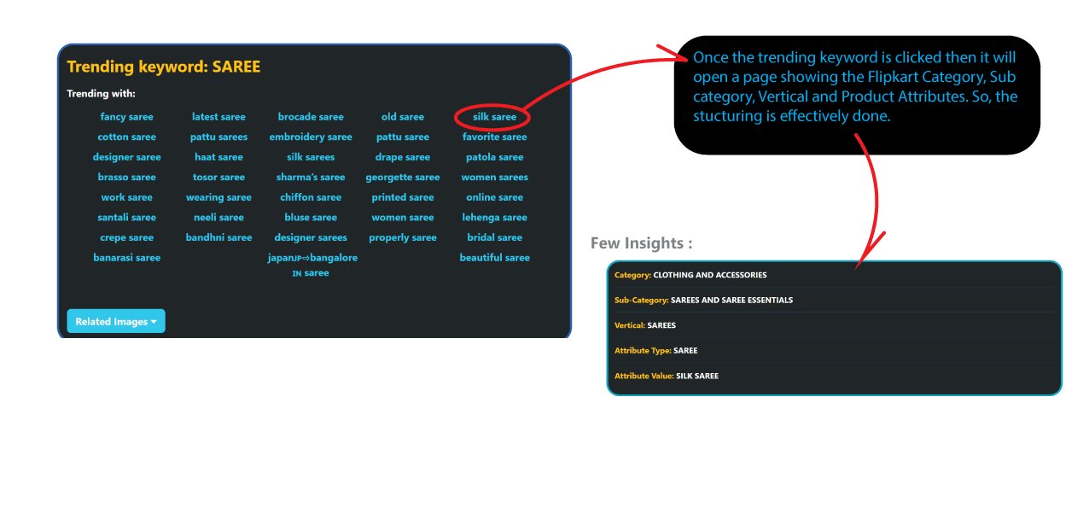
P2: Structured Data According to Flipkart Category, Sub category, Vertical and Product Attributes

Slide 6
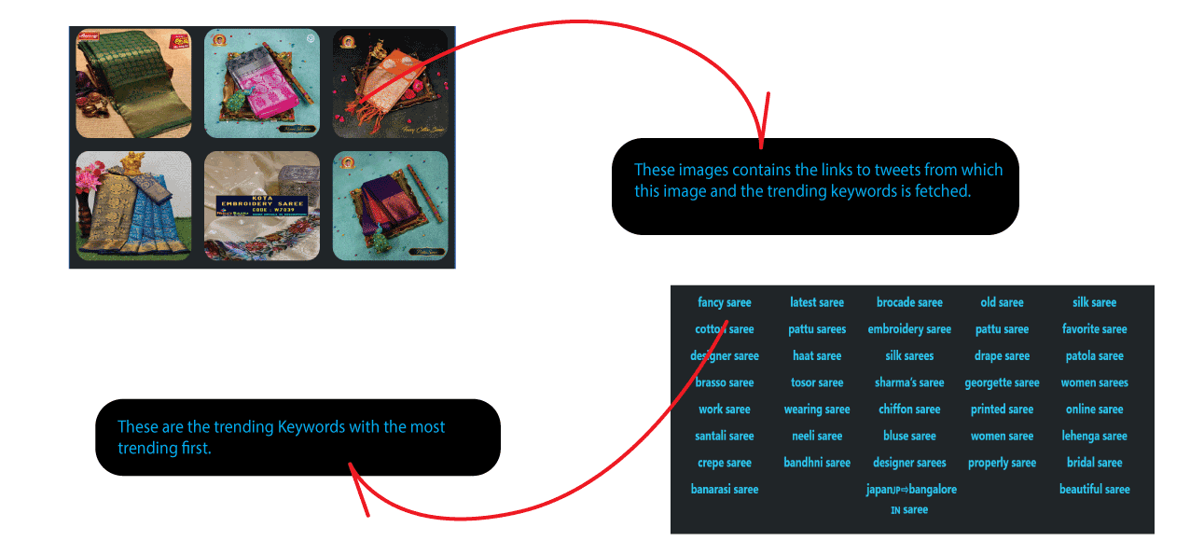
P3: List of trending keywords with sample images and links from which the trend is derived with most trending first:

Slide 7
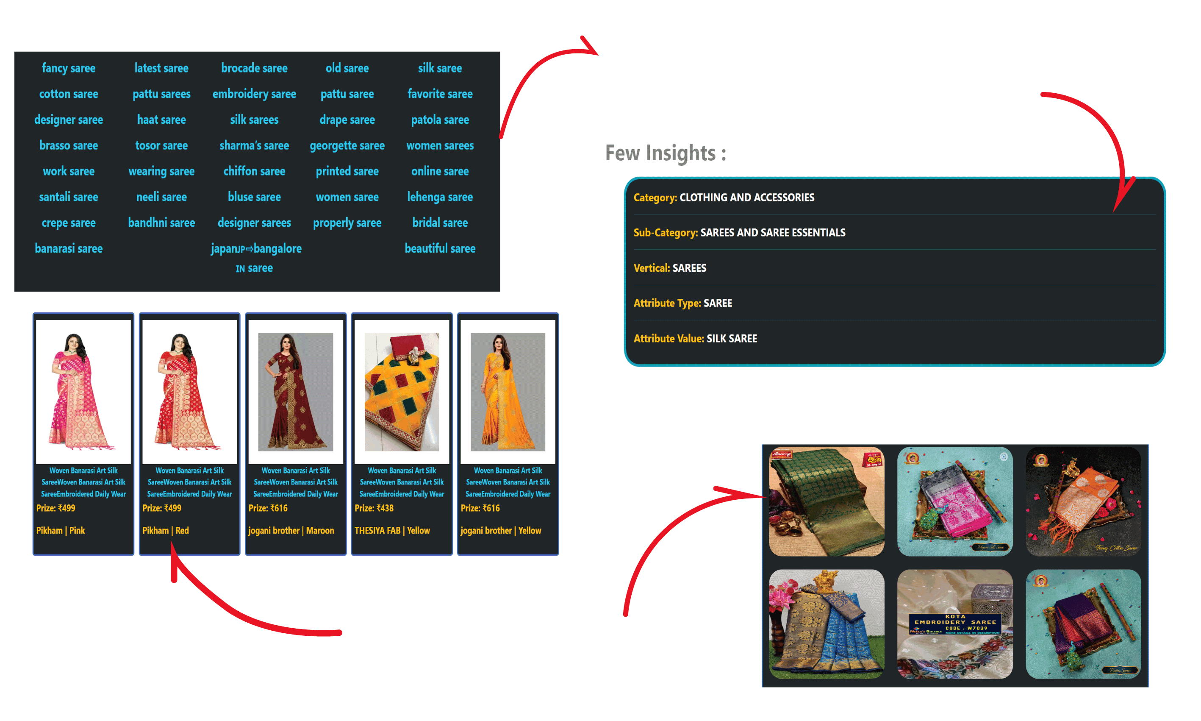
P4: Mapping of Extracted Trending Keywords with Flipkart
If any of these trending keyword is clicked it will open a page displaying all the results scrapped from the Flipkart with their Category, Sub-Category, Veridical, Attribute Type and Value. Also similar products are fetched.
One Can easily see that image fetched from twitter under trending tags is very similar to images on the Flipkart.

Slide 8
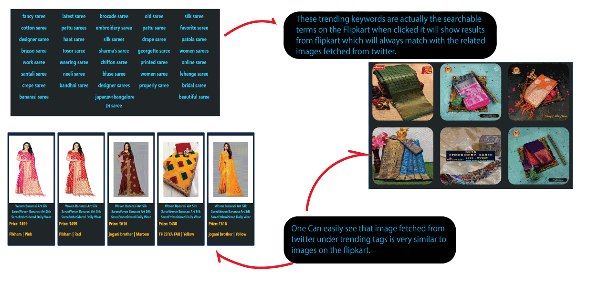
P5: From a trending keyword, creating a corresponding searchable term on Flipkart which will lead to matching products

Slide 9
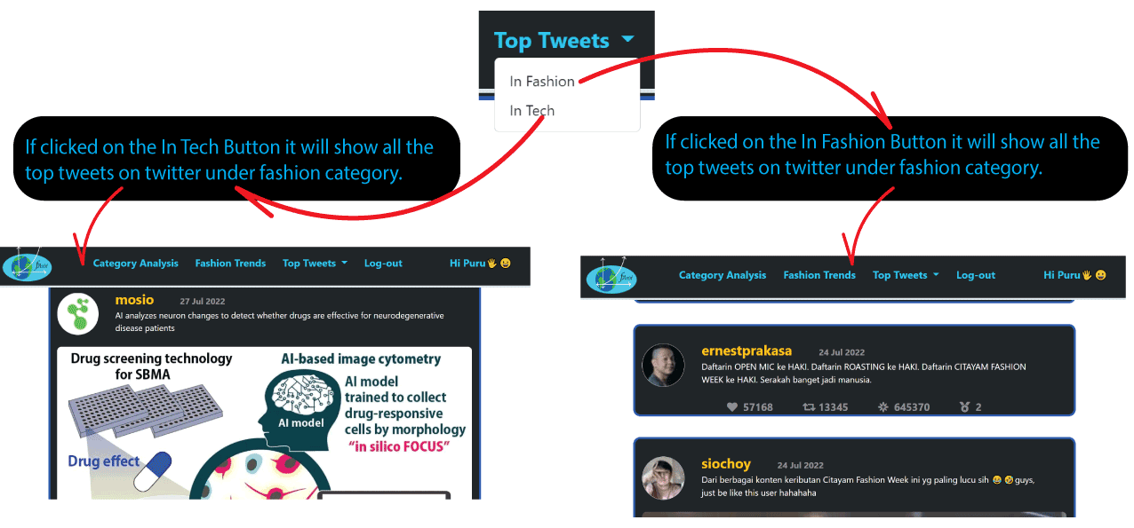
P6: Extra Feauture-1, Top Tweets under Fashion and Tech:
P7: Extra Feauture-2 Ranking/scoring logic for Tweets extracted:
All the tweets under a Category are sorted on the Bases of a algorithm designed by our team which is as fallows:
Retweets are given highest Star-Point which is 10 per Retweet.
Likes are given Second Highest Star-Point which is 9 per Like.
3. Now total Star-Point is reduced on the basis of how old a particular tweet is. 0.1% decrease for 1 day old Tweet.
Also if the tweet contains a media then there is rise in Star-Point of 10000.
Moreover, if the tweet is explicit then there is decrease in the Star-Point of 10000.

Slide 10
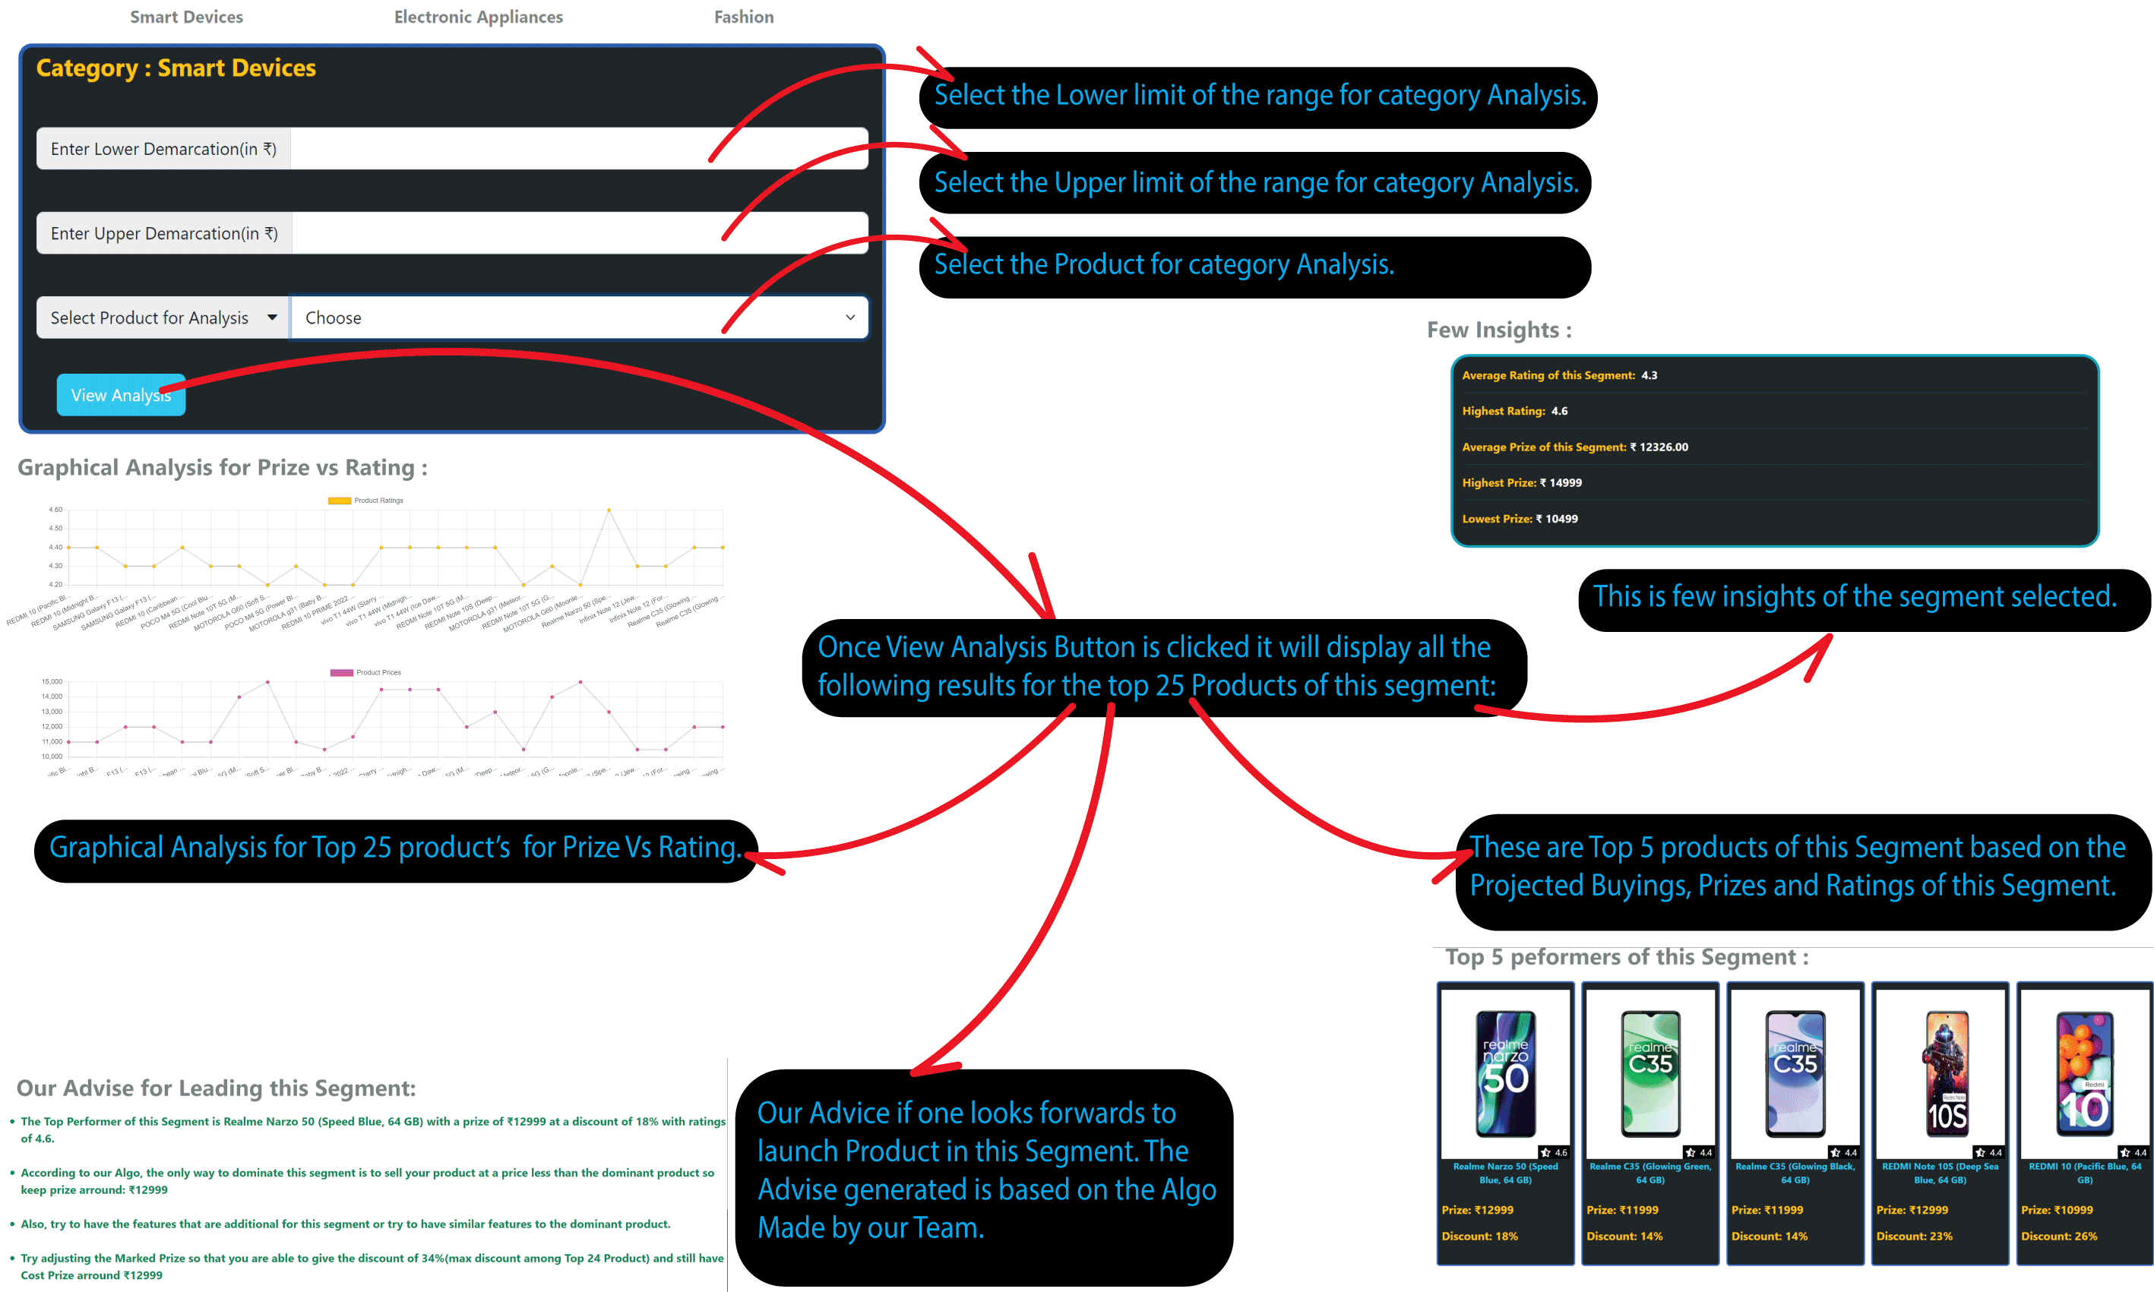
P8: Extra Feauture-3 Category Analysis

Slide 11
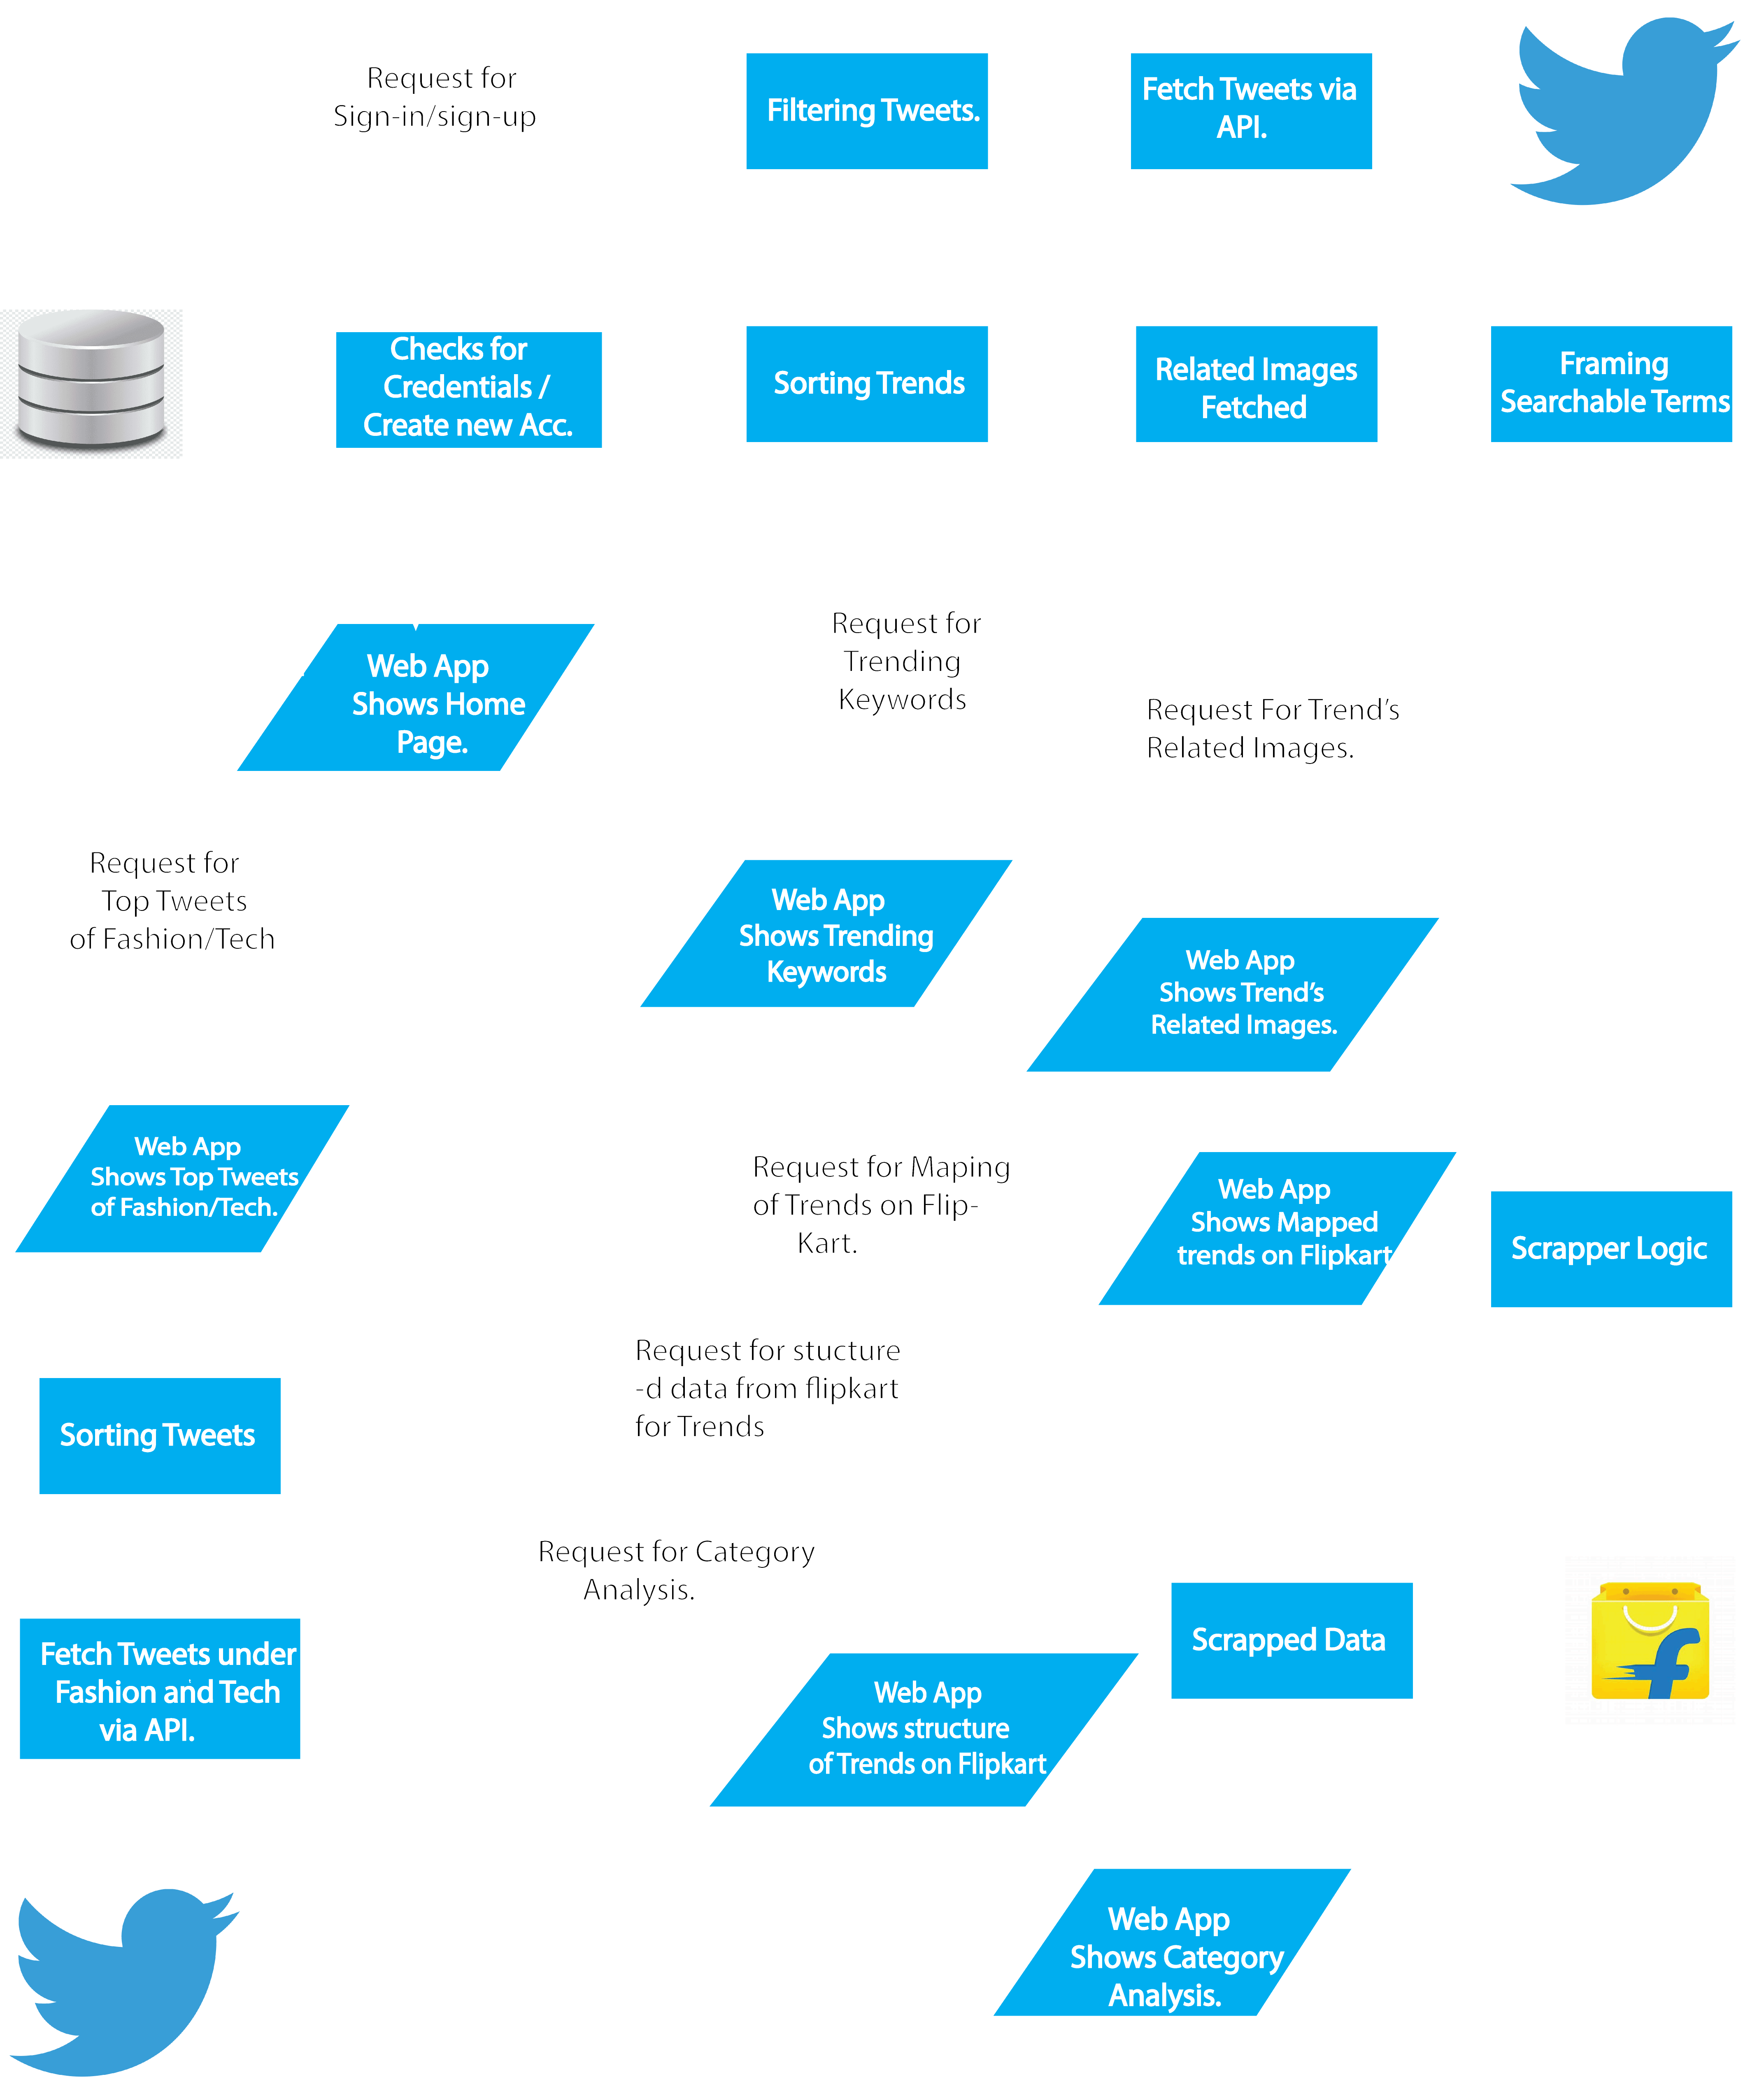
Block Diagram of
Our Project:

Slide 12
Limitations of Our Solution:
Fetch tweets from only Twitter, not Instagram, Facebook, etc.
Need internet connectivity to work.
Till now it's restricted to fashion and tech still there are other fields also.
The user needs to create an account to access the website.
Future Scope Of the Project:
We can fetch trends from Instagram, Facebook, Reddit, etc social media sites to access more trends.
We can have more categories in this Web-app like groceries, furniture, books, sports, etc.

